Slide 1
WELCOME Students to
S. Y. B. Sc.
By
Prof. D. A. Munot

Slide 2
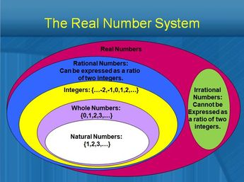

Slide 3
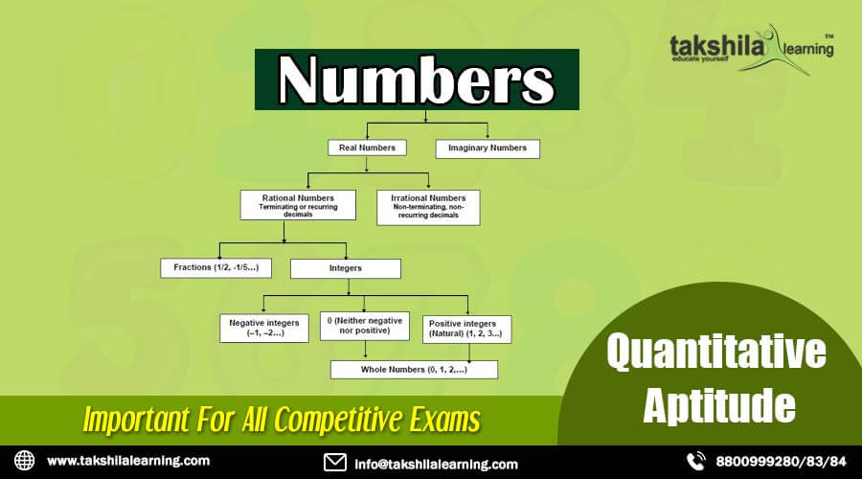

Slide 4
Exercise
Write the Definition of Natural Number, Whole Numbers, Integers, Rationals, Irrationals, Real Numbers etc. with an example.

Slide 5
Thank You…

